Slide 1
Simple forecasting models using r
Samantha gong
Computing and graphics in applied statistics – April 17, 2020

Slide 2
Abstract
There are many types of simple forecasting models, but I will be focusing on four main types -- Naïve Method, Drift Method, Average Method, and Seasonal Naïve Method.
These models are especially important in economics when predicting future reliable models. Using past values on economic variables such as unemployment rate, economists use forecasting models to predict the next period’s value.
In R, we can test out the reliability of these four simple forecasting models and determine which method will result in the most accurate future model using the Box-Ljung Test, testing residuals and analyzing the auto-correlation function plot.

Slide 3
Introduction
There are four simple forecasting models that can be done using R, these include Naïve Method, Seasonal Naïve Method, Drift Method and Average Method.
Many economists use these methods to determine good estimations of future period values. For my project, I will be focusing on the variable of unemployment rate and using these different methods to predict the next month’s unemployment rate. After retrieving different estimations for next period’s unemployment rate, we can test out the reliability of the methods by conducting the Box-Ljung test, testing residuals and analyzing the auto-correlation function plot.
A model is more reliable when residuals are uncorrelated. The Box-Ljung Test gives a p-value for each method. A large p-value signifies that we fail to reject the null hypothesis (residuals are correlated), which results in concluding that residuals are not correlated. Additionally, the ACF plot shows residual correlations as well which can help determine the reliability of these models.

Slide 4
Materials & Methods
Step 1: We begin by extracting data from FRED (economic research data website) for unemployment rates from the past periods. I took data from January 2010 to Dec, 2019. We will be estimating forecasted value for Jan. 2020 and comparing it to the actual data for Jan. 2020 at the end.
Step 2: We will conduct the four simple forecasting models on RStudio and analyze the predicted forecasted values for Jan. 2020.
Step 3: We check the residuals of each method to determine the best forecasting model that would be used to predict future unemployment rates. We will conduct Box-Ljung Tests, analyze the ACF plots, and analyze the residuals.

Slide 5
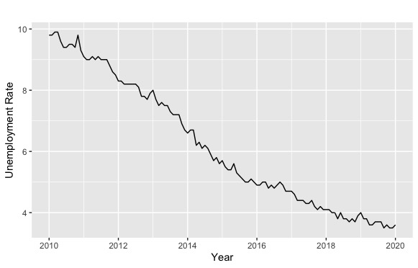
Results (step 1)
After extracting the data from FRED, we plot the graph of the data of unemployment rate from
Jan. 2010 to Dec. 2019.
R Code:
> unemployment = ts(data$UR,frequency=12,start=c(2010,1))
> autoplot(unemployment)+xlab("Year")+ylab("Unemployment Rate")

Slide 6
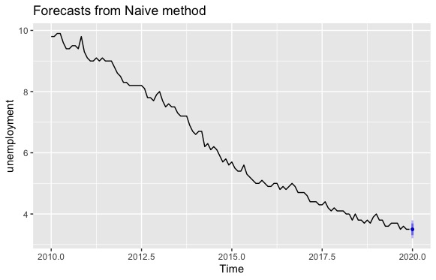
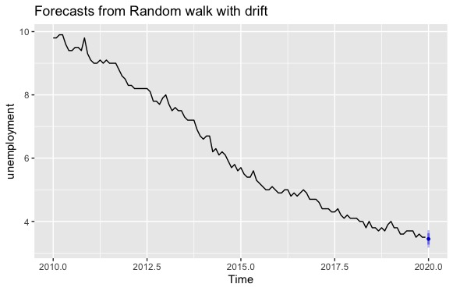
Results (step 2)
The estimated forecasted value for January 2020 is 3.5% with a 95% confidence bound of [3.21, 3.79].
The estimated forecasted value for January 2020 is 3.45% with a 95% confidence bound of [3.17,3.72].

Slide 7
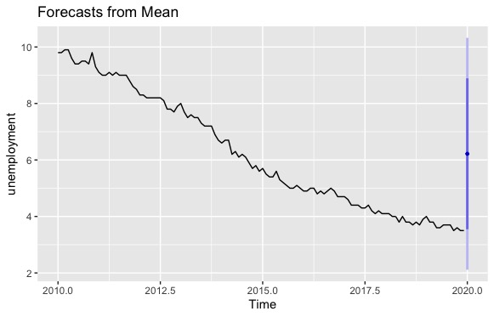
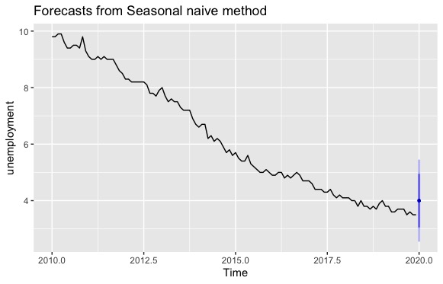
Results (step 2)
The estimated forecasted value for January 2020 is 6.2% with a 95% confidence bound of [2.11,10.32].
The estimated forecasted value for January 2020 is 4.0% with a 95% confidence bound of [2.55,5.45].

Slide 8
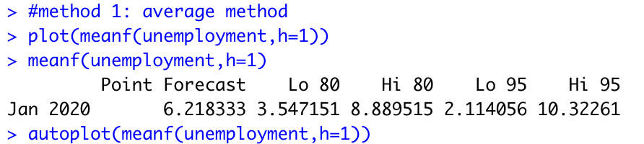
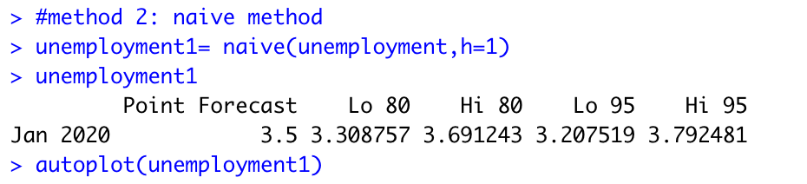
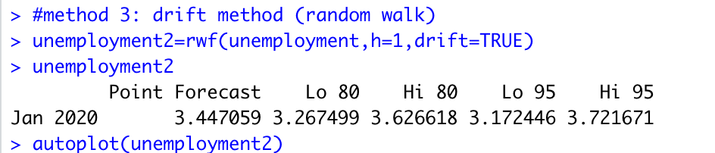
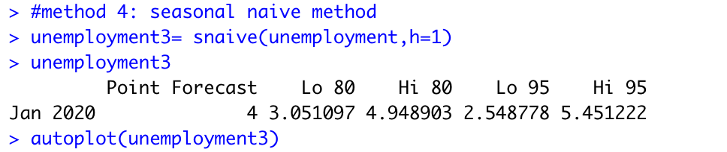
Results (Step 2)
This was the R code and output used to plot the four simple forecasting methods and getting estimated forecasted values for Jan. 2020 with confidence levels
We used package “forecast” in R

Slide 9
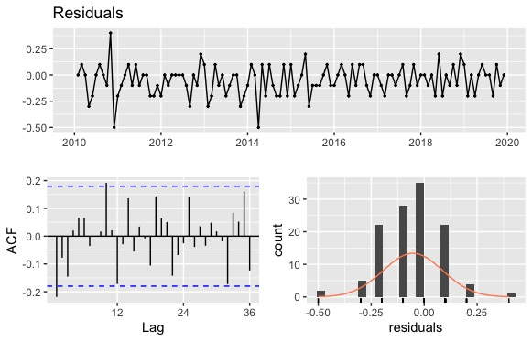
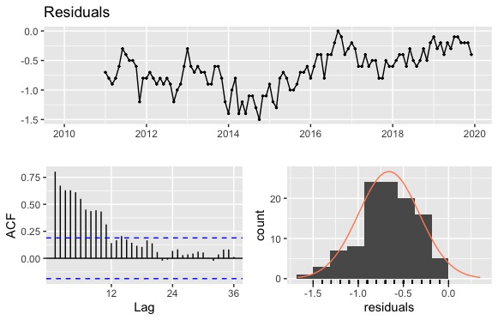
Results (Step 3)
The first plot shows us results for the Naïve Method
The Box-Ljung test gives us a p-value of 0.126. Since the p-value is not small, we fail to reject the null hypothesis and thus, can conclude that the residual correlation is equal to zero. This means that the residuals are uncorrelated making the naïve method a good model in forecasting unemployment rate. We can also see the ACF shows no correlation between residuals and its lagged values.
The second plot shows us results for the Seasonal Naïve Method
The Box-Ljung test gives us a p-value of <2.2e^-16 which means we can reject the null hypothesis and conclude that residual correlation exists. Thus, the seasonal naïve method is not a good model in predicting values for unemployment rate because the residuals are correlated.

Slide 10
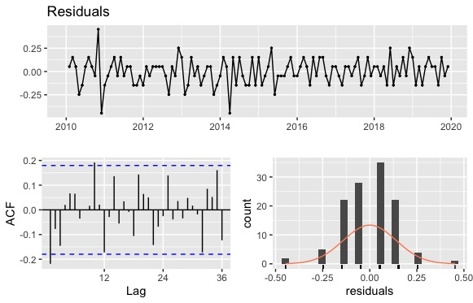
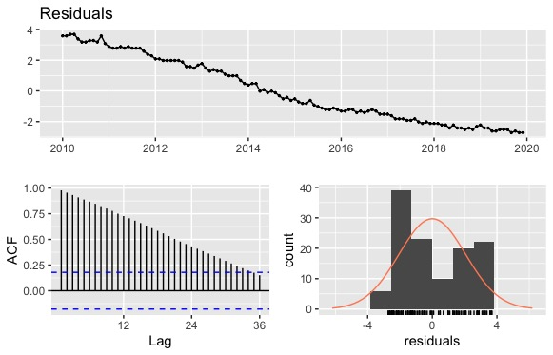
Results (step 3)
The first plot shows the residual plots for the Drift Method.
The Box-Ljung test gives a p-value of 0.126 which is large enough to not reject the null and conclude that the residuals are not correlated. This makes the drift method a good model for forecasting. We can also see the ACF plot does not show correlation between residuals and lagged values.
The second plot on the left shows the residual plots for the Average Method.
The Box-Ljung Test gives a p-value of <2.2e^-16. Since p-value is small, we reject null hypothesis and conclude that the residuals correlation is not equal to zero. This means that the average method is not a good model for forecasting because residuals are correlated.

Slide 11
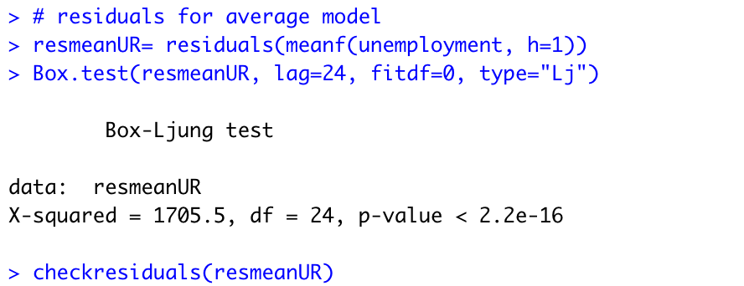
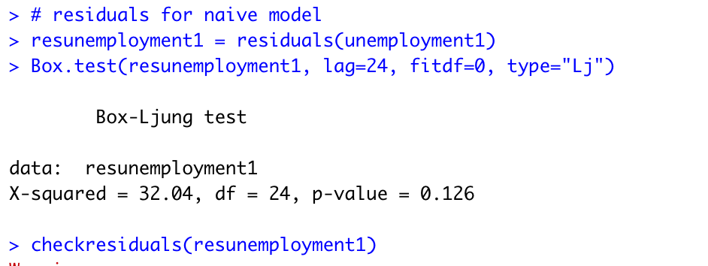
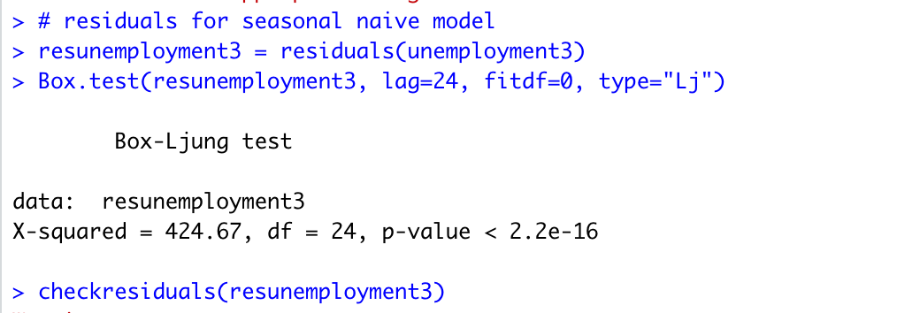
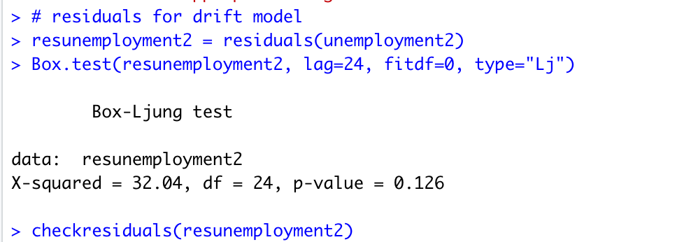
Results (Step 3)
Here is the R Code and Output for step 3

Slide 12
Discussion
Based on the results, we can determine that the drift method and naïve method gives the more reliable forecasting because of the results from the Box-Ljung Test and its p-values.
Thus, we can conclude that a good estimated forecasted value for January 2020 is 3.5%.
Looking at the actual value, we had an unemployment rate of 3.6% for January 2020. This shows that these simple forecasting methods are reliable in determining future values.

Slide 13
Literature cited
Sources:
https://cran.r-project.org/web/packages/forecast/forecast.pdf
https://rpubs.com/RatherBit/90267
https://fred.stlouisfed.org/

